Slide 1
MUZIFA
FINAL PROJECT

Slide 2
PROJECT TITLE
DISEASE PREDICTION
DEPARTMENT :ARTIFICIAL INTELLIGENCE AND DATA SCIENCE
PRESENTED BY: MUZIFA MUBARAK
REGISTER NUMBER :813821243036

Slide 3


AGENDA
Introduction: Highlighting the project's significance in healthcare and its objectives.
Methodology Overview: Explaining data collection, preprocessing techniques, and machine learning algorithms used.
Model Training and Evaluation: Discussing the training process, evaluation metrics, and cross-validation techniques.
Results and Analysis: Presenting individual model performance, accuracy on test data, and confusion matrix analysis.
Conclusion and Future Work: Summarizing findings, addressing limitations, and outlining future research directions.
3/21/2024 Annual Review

Slide 4

PROBLEM STATEMENT
Traditional diagnostic methods face challenges in accurate and timely disease prediction.
Machine learning can overcome these challenges by leveraging data-driven approaches.
This project aims to develop a robust disease prediction system using machine learning techniques.

Slide 5

PROJECT OVERVIEW
Disease prediction is crucial for early detection and better healthcare outcomes.
Machine learning techniques offer a promising approach to predict diseases accurately.
Objective:
Develop a machine learning-based system for disease prediction.
Evaluate the performance of various algorithms in predicting diseases.

Slide 6

WHO ARE THE END USERS?
Healthcare Professionals: Physicians, nurses, and other healthcare providers who utilize the predictions to assist in diagnosis and treatment planning.
Patients: Individuals who benefit directly from early detection and intervention facilitated by the prediction system, enabling them to take proactive measures for their health.
Healthcare Administrators: Managers and decision-makers in healthcare organizations who use the predictions to allocate resources effectively, optimize workflow, and improve patient outcomes.
Researchers: Scientists and researchers who leverage the predictions to advance medical knowledge, develop new treatments, and conduct epidemiological studies.
Public Health Officials: Government agencies and policymakers who utilize the predictions to inform public health initiatives, disease surveillance, and preventive measures.

Slide 7

YOUR SOLUTION AND ITS VALUE PROPOSITION
Early Detection: By analyzing patterns and relationships in medical data, the system can identify potential diseases at an early stage, allowing for timely intervention and treatment.
Precision Medicine: The system enables personalized healthcare by providing tailored predictions based on individual patient data, leading to more targeted and effective treatment strategies.
Improved Patient Outcomes: With early detection and personalized treatment plans, patients experience better health outcomes, reduced disease progression, and enhanced quality of life.
Resource Optimization: Healthcare providers can optimize resource allocation by prioritizing care for patients at higher risk of developing certain diseases, leading to improved efficiency and cost savings.

Slide 8

THE WOW IN YOUR SOLUTION
Accurate Predictions: Our solution leverages advanced machine learning algorithms to provide highly accurate predictions of disease risk, enabling early detection and proactive intervention.
Personalized Healthcare: By analyzing individual patient data, our solution delivers personalized predictions tailored to each patient's unique characteristics, preferences, and medical history, leading to more precise and effective treatment plans.
Real-time Insights: Our solution provides real-time insights into disease trends, patterns, and risk factors, empowering healthcare providers to make informed decisions and take proactive measures to improve patient outcomes.
3/21/2024 Annual Review

Slide 9
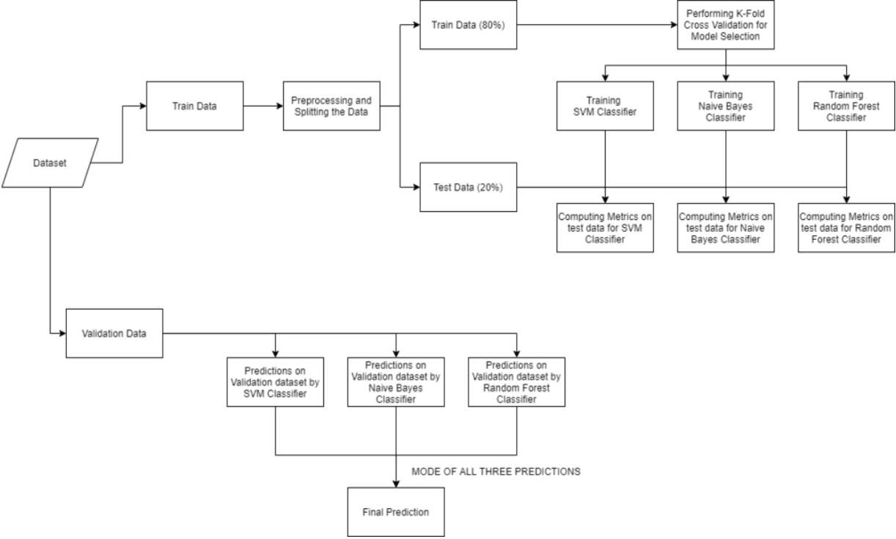
MODELLING

Slide 10
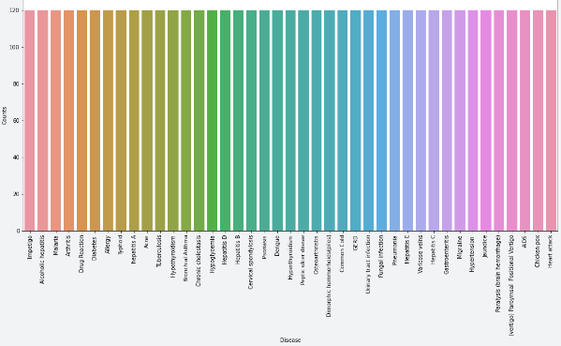
RESULTS
Demo Link

Slide 11
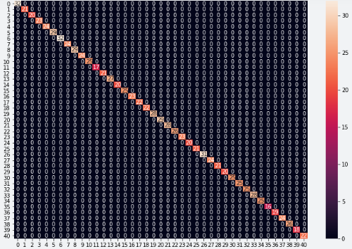
RESULTS
Demo Link

Slide 12
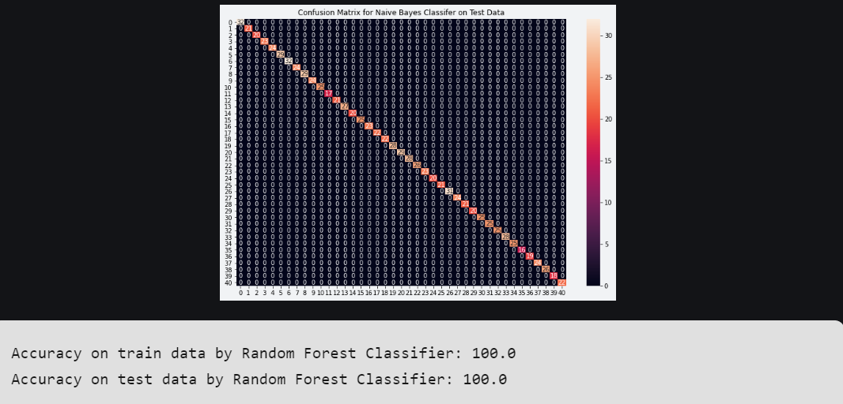
RESULTS
Demo Link

Slide 13
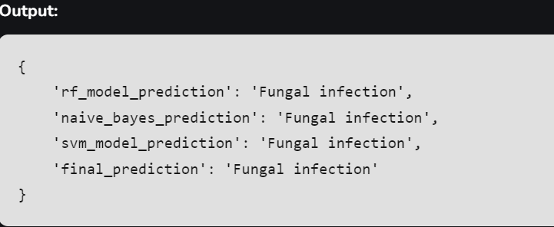
RESULTS
Demo Link

